Slide 1

Inleiding Data Science: Algorithmic Bias
CPO & iCIS Opleiding gegevensbescherming
Prof.dr.ir. Arjen P. de Vries
arjen@acm.org
Nijmegen, May 16th, 2019
GEEN MR…
ru.nl/cpo/cursus/cursussen/aanbod/beschrijving/ie-ict-privacy/cpo-icis-opleiding-gegevensbescherming/

Slide 2
Eigenlijk niet…
Opdracht van Mireille: Kun je studenten uitleggen hoe je een ML systeem zo kunt ontwerpen dat je daadwerkelijk zo weinig mogelijk data verwerkt en toch kwaliteit levert?
KIA Digitale Technologieën – AI (ST2-1), Q2:
Op welke wijze kunnen we deep-learning architecturen data-efficiënt training door expert kennis toe te voegen?

Slide 3

Outline
Big Data
Waarom nou juist BIG data?!
Bias on the Web
Bias in Search Engines
Quantifying Bias using Retrievability
Bias in Word Embeddings
informagus.nl/edu/cpo/

Slide 4
Big Data: nieuwe mogelijkheden!
Om
Data te genereren,
Delen,
Combineren
Analyseren
.. die leiden tot nieuwe inzichten en een nieuwe manier van redeneren.
(bron: Definitie van big data van de Nationale DenkTank)

Slide 5
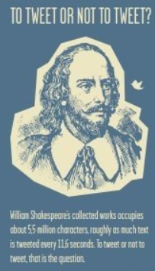
Al het werk van William Shakespeare:
5.500.000 letters…
…wordt geschreven in slechts 11,6 Twitter-seconde!
quora.com/How-much-data-does-Twitter-store-daily

Slide 6
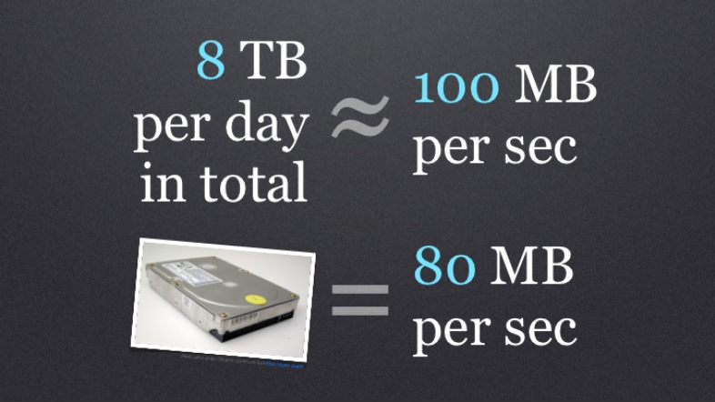
Een wonderlijke puzzel!
slideshare.net/raffikrikorian/twitter-by-the-numbers

Slide 7
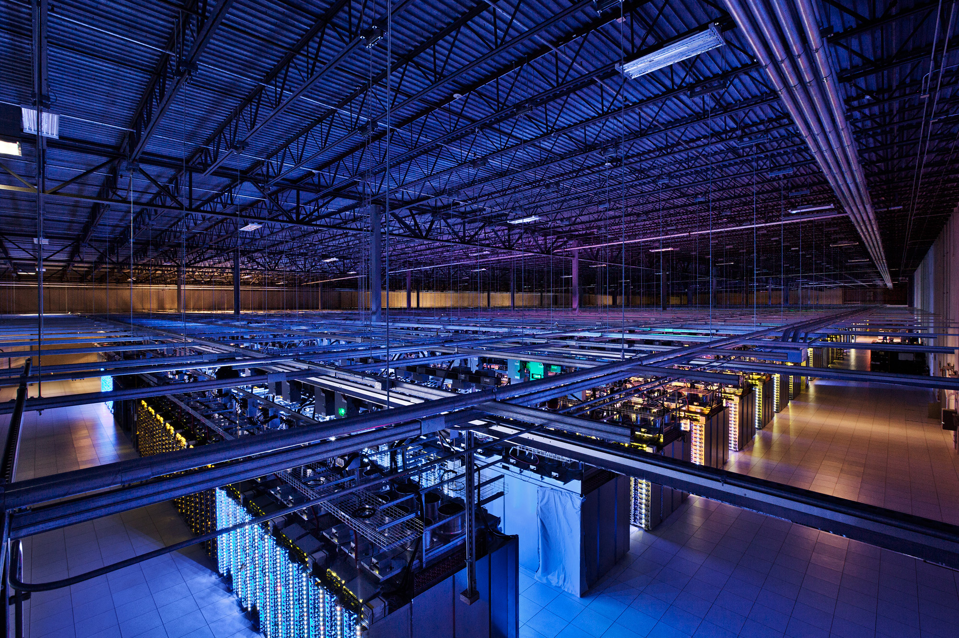
Data Center (is the Computer)
Source: Google

Slide 8
Big Data in NL
Aankopen bij bol.com
Bestemmingen van Booking.com op maat
Advertenties real-time verkopen, bv. bij nu.nl (Sanoma)
Kinderzoekmachine WizeNoze.com
Etc. etc.

Slide 9
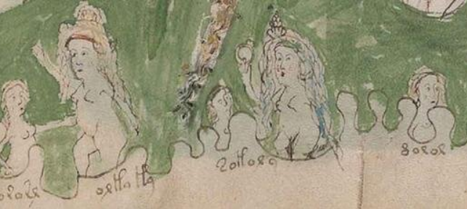
Cracking the Voynich Code
Two women dealing with five children in a bath
The words describe different temperaments: tozosr (buzzing: too noisy), orla la (on the edge: losing patience), tolora (silly/foolish), noror (cloudy: dull/sad), or aus (golden bird: well behaved), oleios (oiled: slippery). These words survive in Catalan [tozos], Portuguese [orla], Portuguese [tolos], Romanian [noros], Catalan [or aus] and Portuguese [oleio]. The words orla la describe the mood of the woman on the left and may well be the root of the French phrase 'oh là là', which has a very similar sentiment.
https://phys.org/news/2019-05-bristol-academic-voynich-code-century-old.html

Slide 10
Cracking the Voynich Code
“It uses an extinct language. Its alphabet is a combination of unfamiliar and more familiar symbols. It includes no dedicated punctuation marks, although some letters have symbol variants to indicate punctuation or phonetic accents. All of the letters are in lower case and there are no double consonants. It includes diphthong, triphthongs, quadriphthongs and even quintiphthongs for the abbreviation of phonetic components. It also includes some words and abbreviations in Latin.”
https://phys.org/news/2019-05-bristol-academic-voynich-code-century-old.html

Slide 11
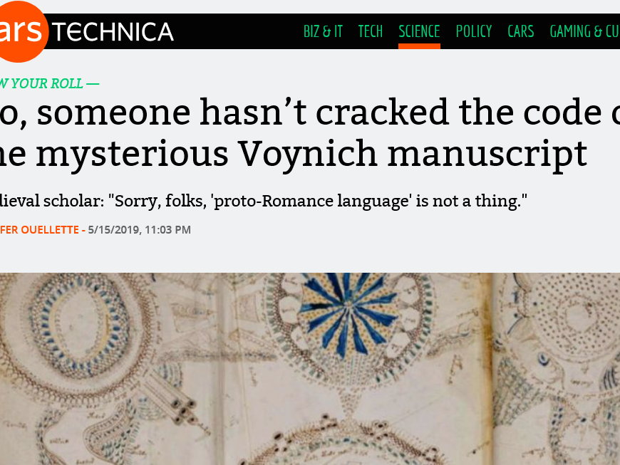
https://arstechnica.com/science/2019/05/no-someone-hasnt-cracked-the-code-of-the-mysterious-voynich-manuscript/

Slide 12
Cracking the Voynich Code
“It uses an extinct language. Its alphabet is a combination of unfamiliar and more familiar symbols. It includes no dedicated punctuation marks, although some letters have symbol variants to indicate punctuation or phonetic accents. All of the letters are in lower case and there are no double consonants. It includes diphthong, triphthongs, quadriphthongs and even quintiphthongs for the abbreviation of phonetic components. It also includes some words and abbreviations in Latin.”
Just like Latin to me!

Slide 13
Computers do this all the time!
“It uses an extinct language. Its alphabet is a combination of unfamiliar and more familiar symbols. It includes no dedicated punctuation marks, although some letters have symbol variants to indicate punctuation or phonetic accents. All of the letters are in lower case and there are no double consonants. It includes diphthong, triphthongs, quadriphthongs and even quintiphthongs for the abbreviation of phonetic components. It also includes some words and abbreviations in Latin.”
Latin

Slide 14
Wat is data?!
Byte = getal tussen 0 en 255

Slide 15
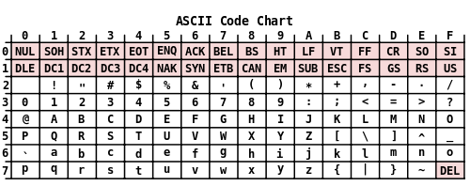
Wat is data?!
Byte = getal tussen 0 en 255 of een getal tussen -128 en +127 ☺
Hoe zit dan dan met letters?

Slide 16
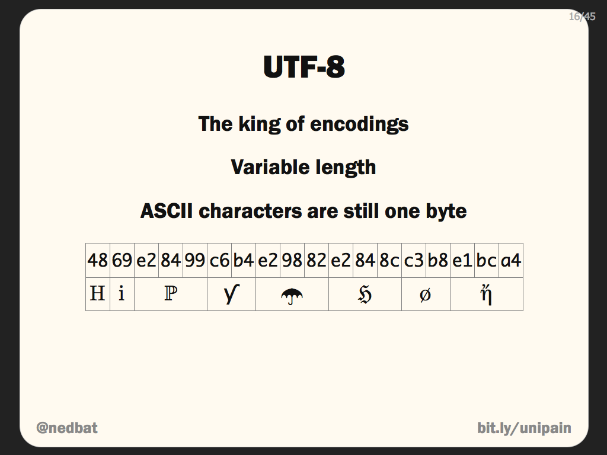

Slide 17
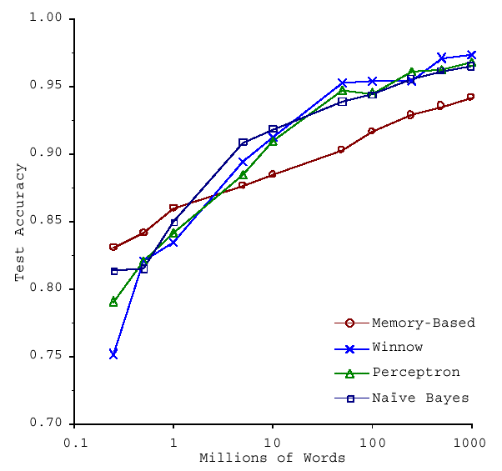
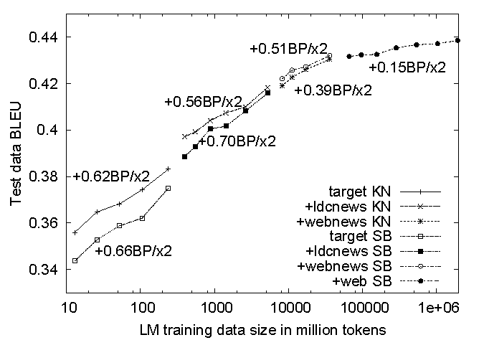
Waarom BIG data? Well… there’s NO data like MORE data!
How do we get here if we’re not Google?
s/knowledge/data/g;
(Banko and Brill, ACL 2001): Large amounts of data
(Brants et al., EMNLP 2007): Variety of data

Slide 18
Use Google Data?!
E.g., Google releases pre-trained word and phrase vectors: “We are publishing pre-trained vectors trained on part of Google News dataset (about 100 billion words). The model contains 300-dimensional vectors for 3 million words and phrases. The phrases were obtained using a simple data-driven approach described in [2]. The archive is available here: GoogleNews-vectors-negative300.bin.gz.”
Hier komen we op terug in de case!
https://code.google.com/archive/p/word2vec/

Slide 19
Machine Learning & Search

Slide 20
“Computational Relevance”
“Intellectually it is possible for a human to establish the relevance of a document to a query. For a computer to do this we need to construct a model within which relevance decisions can be quantified. It is interesting to note that most research in information retrieval can be shown to have been concerned with different aspects of such a model.”
Van Rijsbergen, 1976
Retrieval Model

Slide 21
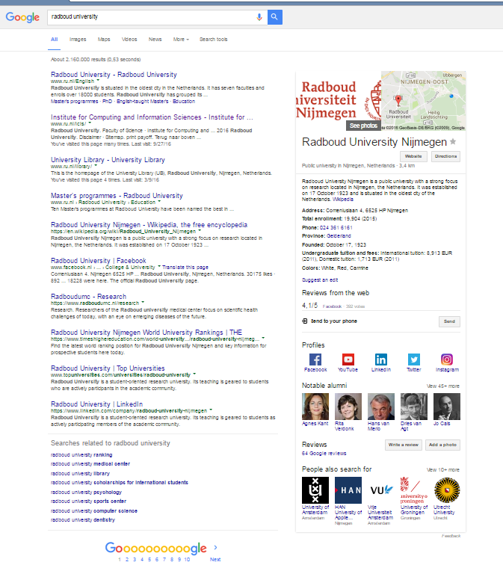
Herken eigennamen
Ordenen zoekresultaten
Voorspel wat jij wilt vinden
Suggesties andere vragen

Slide 22
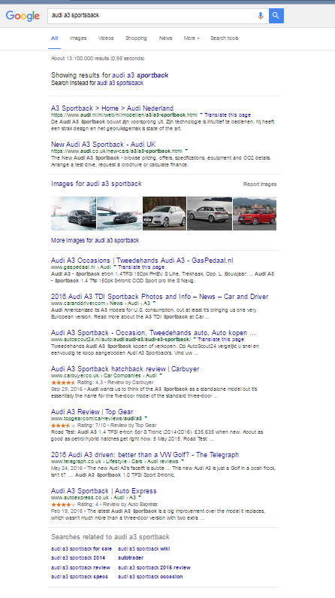
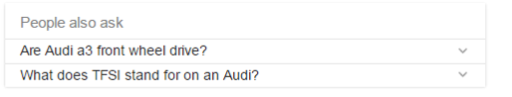
Spelfouten corrigeren
Wat zou de gebruiker willen?
Orden de “verticals”
Suggesties zoekvragen

Slide 23
Search & Privacy

Slide 24
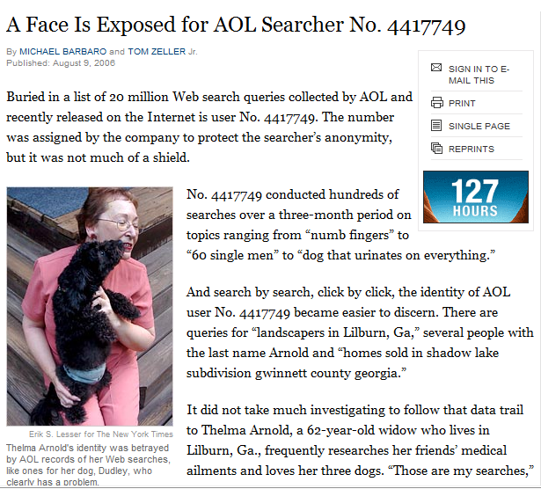
AOL Search Dataset
August 4, 2006: Logs voor academici
3 maanden, 650 duizend gebruikers, 20 miljoen zoekvragen
Anonieme User IDs
August 7, 2006: AOL haalde de data weg, maar… internet vergeet nooit!
August 9, 2006: New York Times identificeert Thelma Arnold
“A Face Is Exposed for AOL Searcher No. 4417749”
Zoekvragen in een kleine gemeenschap, Lilburn, GA (pop. 11k)
Zoekvragen naar specifieke namen (Jarrett Arnold)
NYT journalist benadert alle 14 mensen in Lilburn met achternaam Arnold
Thelma Arnold bevestigt haar zoekvragen
August 21, 2006: 2 AOL werknemers ontslagen, CTO zelf weg
September, 2006: “Class action rechtzaak” ingediend tegen AOL
AnonID Query QueryTime ItemRank ClickURL
---------- --------- --------------- ------------- ------------
1234567 uw cse 2006-04-04 18:18:18 1 http://www.cs.washington.edu/
1234567 uw admissions process 2006-04-04 18:18:18 3 http://admit.washington.edu/admission
1234567 computer science hci 2006-04-24 09:19:32
1234567 computer science hci 2006-04-24 09:20:04 2 http://www.hcii.cmu.edu
1234567 seattle restaurants 2006-04-24 09:25:50 2 http://seattletimes.nwsource.com/rests
1234567 perlman montreal 2006-04-24 10:15:14 4 http://oldwww.acm.org/perlman/guide.html
1234567 uw admissions notification 2006-05-20 13:13:13
…
Tnx Jamie Teevan
Notes:
Released at SIGIR 2006
Thelma Arnold, a 62 year old woman from Lilburn, GA
Lawsuit asking for $5000/user
http://en.wikipedia.org/wiki/AOL_search_data_scandal
http://www.nytimes.com/2006/08/09/technology/09aol.html?_r=1
Basic Collection Statistics
Dates: 01 March, 2006 - 31 May, 2006
Normalized queries:
36,389,567 lines of data
21,011,340 instances of new queries (w/ or w/o click-through)
7,887,022 requests for "next page" of results
19,442,629 user click-through events
16,946,938 queries w/o user click-through
10,154,742 unique (normalized) queries
657,426 unique user ID's
Please reference the following publication when using this collection:
G. Pass, A. Chowdhury, C. Torgeson. A Picture of Search. The First International Conference on Scalable Information Systems, Hong Kong, June 2006.

Slide 25
AOL Search Dataset
Anonieme IDs geen garantie voor anonimiteit
Logs bevatten direct identificerende informatie:
Namen, telefoonnummers, credit cards, BSNs
Tevens indirect identificerende informatie:
Thelma’s vragen uit het NYT artikel
Geboortedatum, geslacht en postcode is voldoende om 87% van de Amerikanen uniek te identificeren!
Tnx Jamie Teevan
Notes:
User 927:
Inspired theatrical production by Katharine Clark Gray
User 711391:
Middle-aged woman, has an affair, ends it, tries to save her marriage.

Slide 26
Bias & Machine Learning

Slide 27
Computers Struggling with Text
Microsoft Tay: chatbotslife.com/the-accountability-of-ai-case-study-microsofts-tay-experiment-ad577015181f
Amazon’s AI recruiting tool: reuters.com/article/us-amazon-com-jobs-automation-insight/amazon-scraps-secret-ai-recruiting-tool-that-showed-bias-against-women-idUSKCN1MK08G

Slide 28
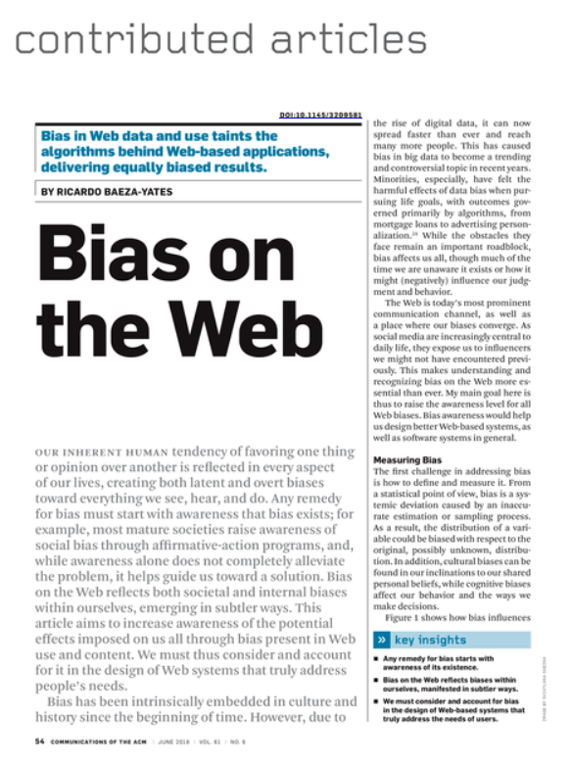
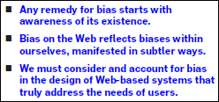
Key Insights

Slide 29
Bias on the Web – Highlights
Activity Bias
In many collections, a few contributors create half the data:
Two Twitter datasets: 0.05% of the most popular people attracted almost 50% of the participants in the 1st and 2% of the users generated 50% of the tweets in the 2nd dataset
Facebook dataset: 7% of active users produced 50% of the posts
Amazon reviews dataset: 4% of active users produced 50% of reviews (fraud?)
Wikipedia: 2000 people (0.04% of registered editors) wrote half of the entries of English Wikipedia
A “Digital Desert” of Web content no-one ever sees

Slide 30
Bias on the Web – Highlights
Data Bias
50% of popular web sites are in English…
… but percentage of native English speakers is only 5%, all English speakers 13% (Disclaimer: stated source is Wikipedia.)
Own example: POI recommendation using geo-tagged Flickr photos: everyone visiting Paris visits the Eiffel Tower…
Consequence: optimizing for a data driven performance measure like accuracy forces the approach to recommend the Eiffel Tower even if this is a useless recommendation!

Slide 31
Bias on the Web – Highlights
UI/UX influence on collected data:
Presentation Bias
You can only click on what you see!
Position Bias
You only see where you look!
Click distributions only useful when de-biased!
Second-order bias originating in personalization: biasing content to our own pre-existing selection biases?

Slide 32
Question:
How to quantify the ranking bias in search engines?

Slide 33
Retrievability
Measures bias in the access of documents in a collection
L. Azzopardi and V. Vinay. Retrievability: An evaluation measure for higher order information access tasks. In Proceedings of the 17th
ACM Conference on Information and Knowledge Management, CIKM ’08, pages 561–570, New York, NY, USA, 2008. ACM.

Slide 34
Retrievability
Measure the accessibility of all documents in a collection given a set of queries
Retrievability score r(d) measures how often document d is retrieved by a given set of queries

Slide 35
Retrievability
Measure the accessibility of all documents in a collection given a set of queries
Retrievability score r(d) measures how often document d is retrieved by a given set of queries
“Evaluate” a retrieval method by the distribution of retrievability scores generated:
Lorenz curve visualizes the inequality
Gini coefficient quantifies the inequality

Slide 36
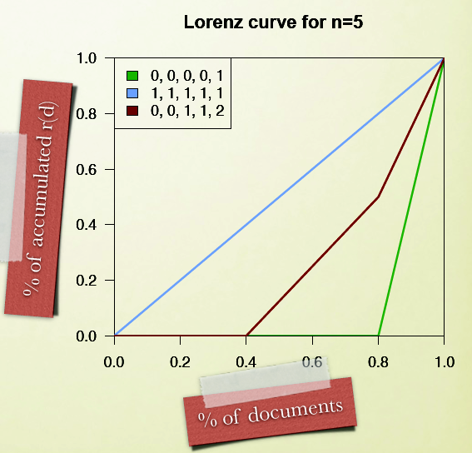

Slide 37
Relationship bias and effectiveness?
Prior work indicates that high effectiveness (measured using P@10 and MAP) correlates with low “retrievability bias”
Azzopardi, L.,Bache, R.:On the relationship between effectiveness and accessibility. In: Proceedings of the 33rd International ACM SIGIR Conference on Research and Development in Information Retrieval, pp. 889–890. ACM (2010)

Slide 38
Retrievability & Ranked Retrieval
Every document is always retrieved!

Slide 39
Retrievability & Ranked Retrieval
Every document is always retrieved!
Consider a cut-off, that corresponds intuitively to the amount of effort we expect a user to be willing to invest in learning the answer to their query
E.g., cut-off of 10: retrievability score equals the number of times this document is retrieved in the top 10 of the results for each of the queries in the (given) query set

Slide 40
“… by a given set of queries”
Q: How do we get the set of queries for which to measure retrievability?
Note: Choice of query set matters, see:
Bashir, S., Rauber, A.: Analyzing document retrievability in patent
retrieval settings. In: International Conference on Database and
Expert Systems Applications, pp.753–760. Springer (2009)

Slide 41
Simulation
Original study:
Draw at random a large set of single terms and bigrams (from the documents in the collection)
Inspired by “Query Based Sampling” for resource description in non-cooperative federated search
Applied in our study on the Dutch Web Archive:
2M most frequent terms (frequencies ranging from 5 to 200M)
2M most frequent bigrams (frequencies ranging from 20 to 35M)

Slide 42
Alternative “Query” Set
Our study, on the Dutch Web Archive:
Anchor Text from external links
De-duplicated for year of crawl
(Most sites crawled once a year, but a subset more frequently.)
Side note:
searsia.org/blog/2017-03-18-query-suggestions-without-tracking-users/
New iCIS professor!

Slide 43
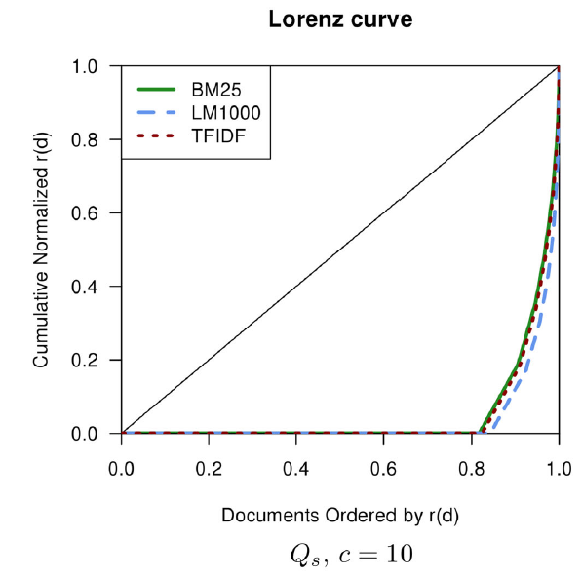
Retrievability Score Inequality (“All”)

Slide 44
Zero Retrievability
Original approach:
If a document is never retrieved by any query, r(d) = 0
Alternative (“union”):
Consider only the documents that are retrieved by at least one of the methods under consideration
Fair comparison across retrieval methods for a given cut-off
Reduces the impact of the high number of documents that has a retrievability score of 0

Slide 45
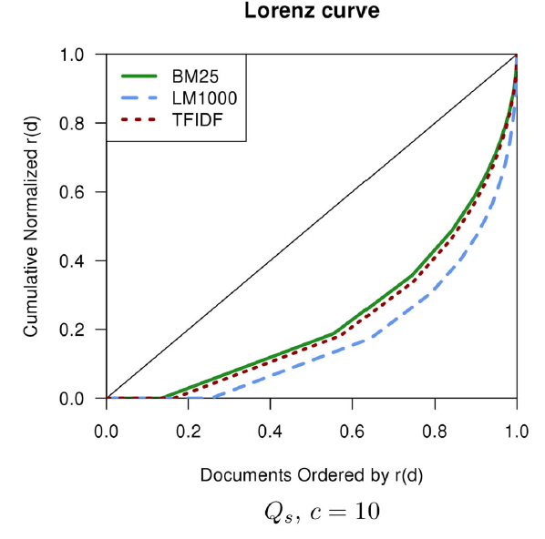
Retrievability Score Inequality (“Union”)

Slide 46
Retrievability = Findability?
Divide collection in 4 equi-sized bins
Using wealth distribution (area under the curve)
Can a document be found if the user queries the collection using a query sampled from that document?
Need to take care to create a reasonable artificial known-item query…
Documents that are “highly retrievable” are significantly easier to find (using MRR to evaluate effectiveness)

Slide 47
Conclusions
Analysis of retrievability helps understand the behaviour of retrieval systems, and makes explicit the inherent biases that affect the retrieved results
Knowing which documents are particularly hard to find allows the institutions to improve their retrieval systems and the users to adapt their search strategies and be aware of the retrieval bias and the source of that bias

Slide 48
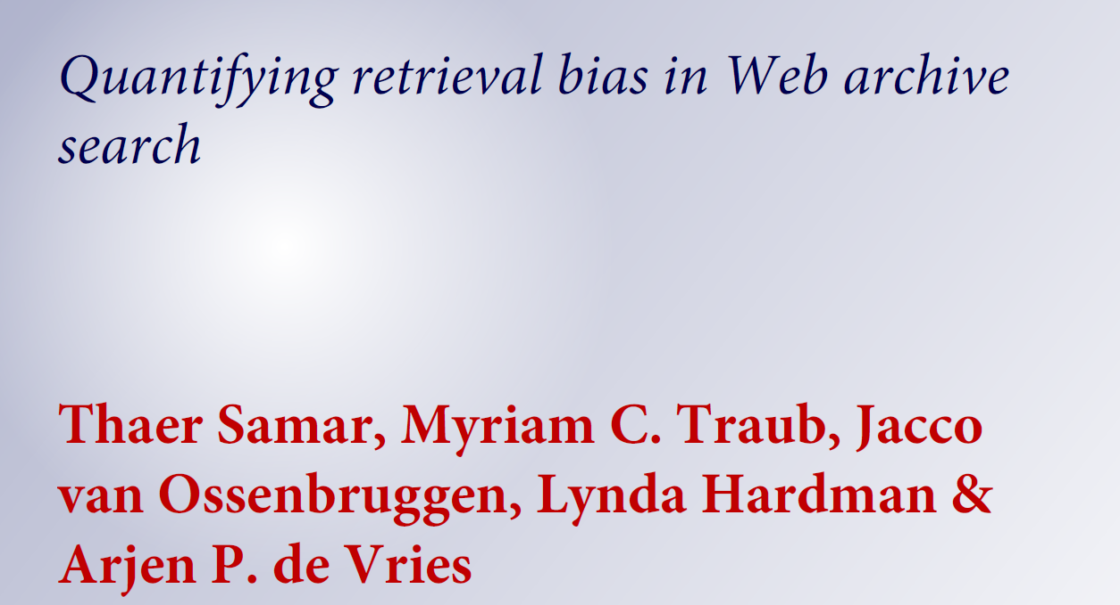

http://dx.doi.org/10.1007/s00799-017-0215-9

Slide 49
Quantifying Bias is not Enough!
Retrievability compares ranking algorithms, so it can quantify bias – we can choose the least biased algorithm, but cannot reduce the bias observed
Recent work by Singh and Joachims corrects bias in the exposure of items (due to presentation bias) associated to user groups; to ensure a fair exposure of those groups
https://arxiv.org/abs/1802.07281

Slide 50
Juridische Context
Data Protection by Design (art. 25) eist dat het risico op inbreuken op fundamentele rechten en vrijheden zoveel mogelijk wordt gemitigeerd (bv., onrechtmatige discriminatie op grond van etniciteit of gender)

Slide 51
Case: informagus.nl/edu/cpo/

Slide 52
Juridische Context
Data Protection Impact Assessment (art. 35) eist dat bij een hoog risico op inbreuken op fundamentele rechten en vrijheden een uitgebreid impact assessment wordt gemaakt, waarbij mitigerende maatregelen zoals DPbD worden genomen zodat het risico afdoende wordt ingeperkt

Slide 53
Open Problems

Slide 54
Question (without an Answer)
How to determine the impact of the bias inherent in any sample of the Web that you are exposed to (“you” being a person or an algorithm)?

Slide 55
Legal Context
GDPR recital 71: the data controller should take measures to “[prevent] discriminatory effects on natural persons on the basis of racial or ethnic origin, political opinion, religion or beliefs, trade union membership, genetic or health status or sexual orientation ...”

Slide 56
Discussion I: Awareness
Bias on the Dutch Web / Social Media
Case studies on CommonCrawl and/or KB Web Archive
Methods and techniques
Explore and extend current / develop new techniques
Tools for the average Web user
My research: Personal Web Archives, to help you understand and reflect on biases you are exposed to

Slide 58
Discussion II: Exploitation vs. Exploration
Measures that do not discourage exploration
Countering the Popularity Bias
Can we somehow quantify future rewards, not just current rewards (?)
Best Paper SIGIR 2018:
Should I Follow the Crowd? A Probabilistic Analysis of the Effectiveness of Popularity in Recommender Systems ir.ii.uam.es/pubs/sigir2018.pdf
Properties of measures informing better experimental designs

Slide 59
Discussion III: Explanations
Insight in how classifiers etc. decide – not trivial for tools like deep networks over, say, character sequences
Challenge:
How to create a Ground Truth? When is an explanation of an algorithmic decision a good explanation?

Slide 60
Discussion III: Explanations
Example from https://arxiv.org/abs/1801.06422
belongs to the newsgroup sci.electronic
“More importantly, a good explanation method should not reflect what humans attend to, but what task methods attend to. For instance, the family name “Kolstad” has 11 out of its 13 appearances in the 20 newsgroups corpus in sci.electronic posts. Thus, task methods probably learn it as a sci.electronics indicator. Indeed, the explanation method in Fig 1 (top) marks “Kolstad” as relevant, but the human annotator does not.”

Slide 61
Discussion IV: De-biasing data?
Compare measures on social media or web data to those from more traditional data (e.g., demo-graphics, CBS)
Integrate observations from different sources; e.g., use population density as well as geo-located Tweet frequency to counter geographical bias
De-bias representations derived from biased data (?)
E.g., word embeddings (e.g. Bolukbasi et al. “Man is to computer as woman is to homemaker?”)
Note: discrimination-aware data mining is far from trivial: https://people.cs.kuleuven.be/~bettina.berendt/Talks/berendt_2017_11_24_final.pdf

Slide 62
Other research themes to explore:
Transparency and accountability of algorithms:
Awareness
Access and redress
Accountability
Explanation
Data provenance
Auditability
Validation and testing
fairness-measures.org/
ACM U.S. Public Policy Council. Statement on Algorithmic Transparency and Accountability, ACM, Washington, D.C., Jan. 2017; https://www.acm.org/binaries/content/assets/public-policy/2017_usacm_statement_algorithms.pdf

